Slide 1


We can read sight words.

Slide 2

or

Slide 3
one

Slide 4

had

Slide 5

by

Slide 6

words

Slide 7

but

Slide 8

not

Slide 9

what

Slide 10
all

Slide 11

were

Slide 12

we

Slide 13

when

Slide 14

your

Slide 15
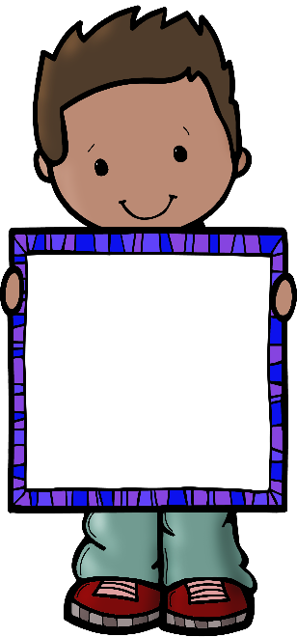
can

Slide 16

said

